Slide 1



VISHWAKARMA INSTITUTE OF TECHNOLOGY, PUNE.
SOLDIER HEALTH AND POSITION TRACKING SYSTEM

Slide 2

PROBLEM STATEMENT
  Designing a Soldier Health and Position System to enhance the well-being and safety of military personnel by integrating real-time health monitoring and accurate position tracking.
  This system aims to provide critical health data and location information to the base stations, enabling swift response to emergencies and optimizing strategic decision-making on the battlefield.

Slide 3

INTRODUCTION
  In modern warfare, ensuring the well-being and effective deployment of soldiers is paramount. The Soldier Health and Position System addresses this imperative by amalgamating cutting-edge technologies to monitor soldiers' health in real-time and precisely track their positions.
  By seamlessly integrating health monitoring and precise positioning, the system acts as a force multiplier, enhancing the overall efficiency and safety of military operations on the battlefield.

Slide 4

OBJECTIVES
The primary objectives of this project are:
  Implement real-time health monitoring for continuous tracking of soldiers' vital signs.
  Develop precise position tracking using GPS and inertial sensors to enhance situational awareness.
  Integrate health and position data streams to create a unified information system.

Slide 5
TECHNOLOGY AND COMPONENTS
Hardware
Software
  Arduino Uno
  SIM900A GSM Module
  Neo-6m GPS Module
  LDR Module
  16x2 LCD Display
  I2C (Inter-Integrated Circuit)
  LM-35 Temperature Sensor
  Arduino IDE
  Google Maps

Slide 6
METHODOLOGY
The methodology for developing The soldier health and position monitoring system:
  Involves setting up the hardware using Arduino Uno, LM35 for body temperature monitoring, LDR for heartbeat counting, GPS module for precise positioning, push button for user-triggered actions, 16x2 LCD display for real-time updates, I2C for efficient communication, and the SIM900A GSM module for emergency alerts.
  Key steps include sensor data acquisition for monitoring body temperature and heartbeat using LM35 and LDR, respectively. The push button enables user-triggered actions it can be used in case where the soldier needs to send an emergency alert to base.The SIM900A GSM module facilitates communication, allowing the system to send emergency alerts via SMS. The Arduino code governs system logic.

Slide 7
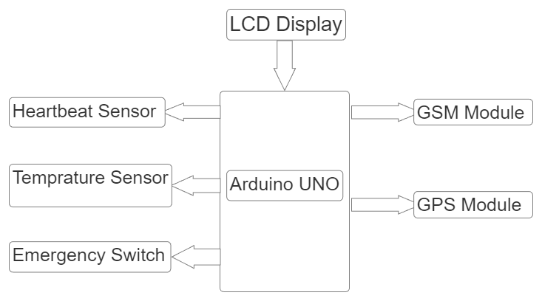
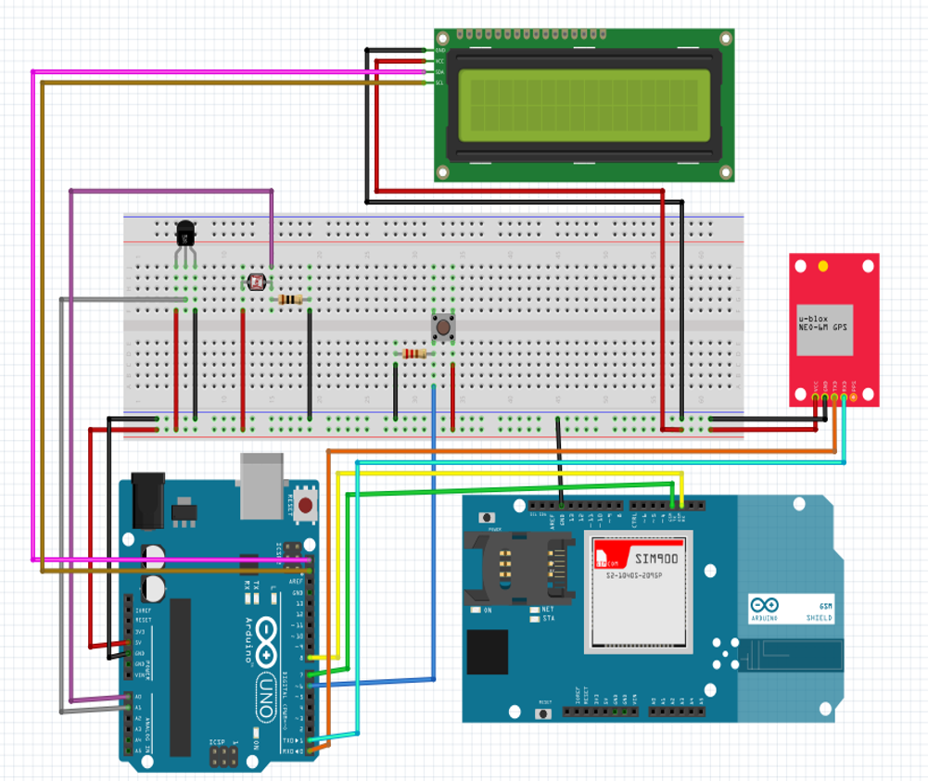
Fig.1. Block Diagram
Fig.2. Circuit Simulation

Slide 8
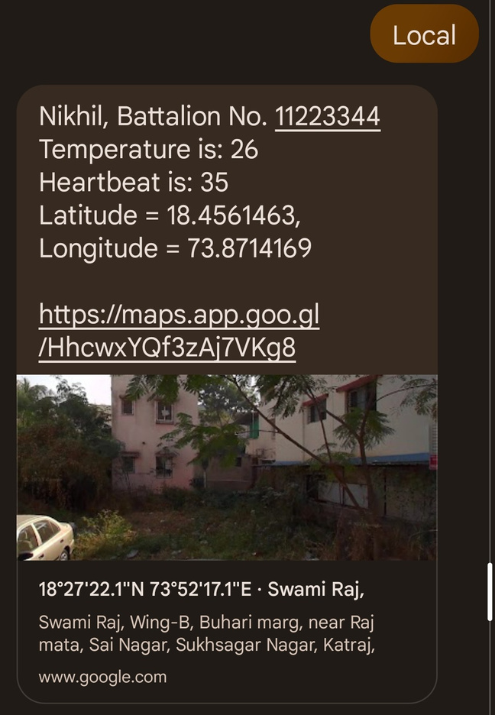
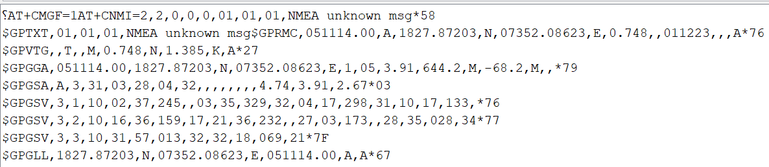
RESULTS
Fig.2.Screenshot of Serial Monitor
Fig.1. Message of various parameters
and soldier location

Slide 9

CONCLUSION
  Soldier Health and Position System represents a crucial advancement in military technology, offering a holistic approach to enhance the overall well-being and operational efficiency of military personnel.
  By seamlessly integrating real-time health monitoring and precise position tracking, this system provides commanders with invaluable insights for informed decision-making on the battlefield.
  The fusion of health and position data not only enables swift responses to emergencies but also contributes to optimizing strategic planning. As we navigate the complexities of modern warfare, investing in such comprehensive systems is imperative, ensuring the safety, health, and effectiveness of our armed forces in the face of evolving challenges.

Slide 10

THANK YOU
FOR WATCHING.

